Slide 1
IMPACTS OF CLIMATE CHANGE ON FORESTRY INDUSTRY
Presented by Jude Tabi
Forestry Department

Slide 2
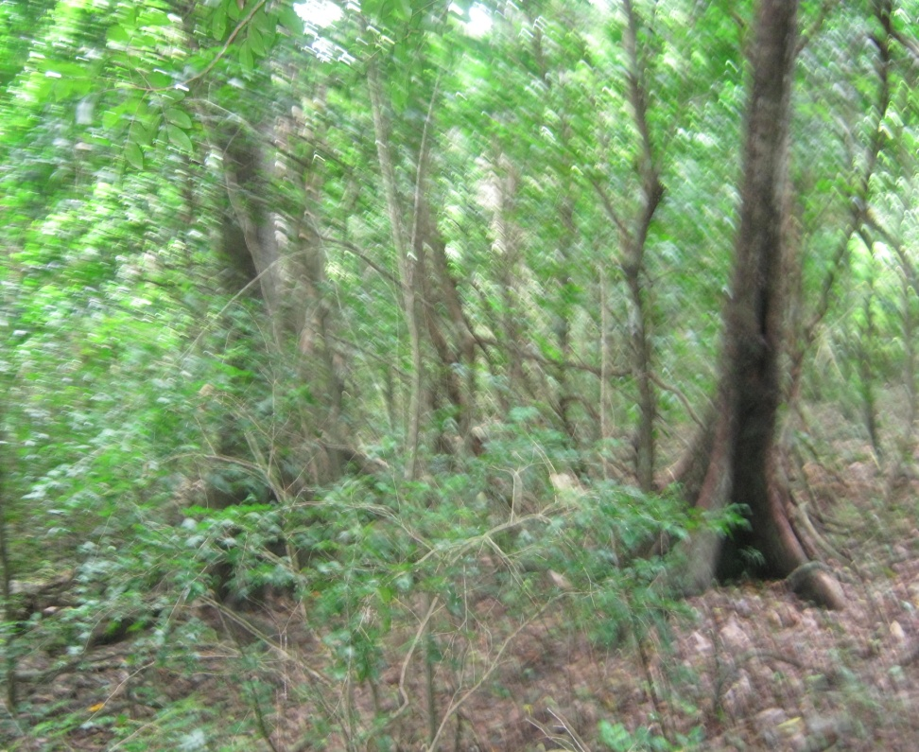
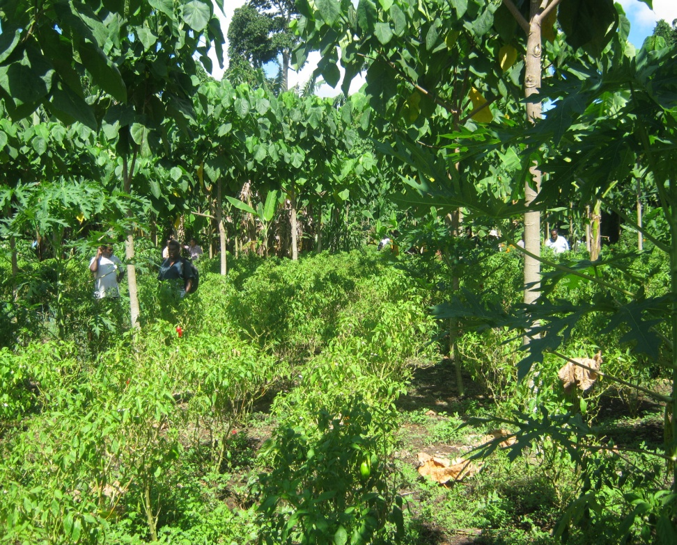
Introduction of session
Tolerant species must be carefully selected for forestry plantations to be able to adapt to CC impacts.
History records that some trees naturally adapt to climate change.

Slide 3
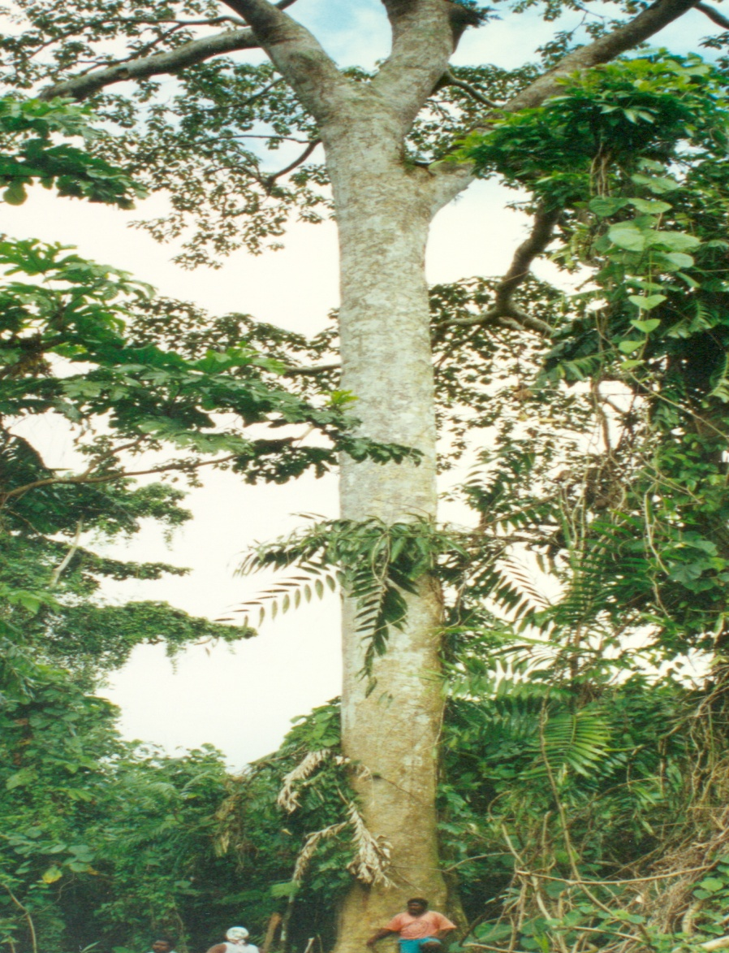
What are the impacts of Climate Change on Forestry?
Flowering and fruiting of trees.
Healthy mother trees destroyed by cyclones.
Increase & decrease in temperature – seedlings cannot survive.
Long periods of rain delaying logging activities.
Heart rot caused by cyclones.
Timber sold in green (wet) form rather that dried.

Slide 4
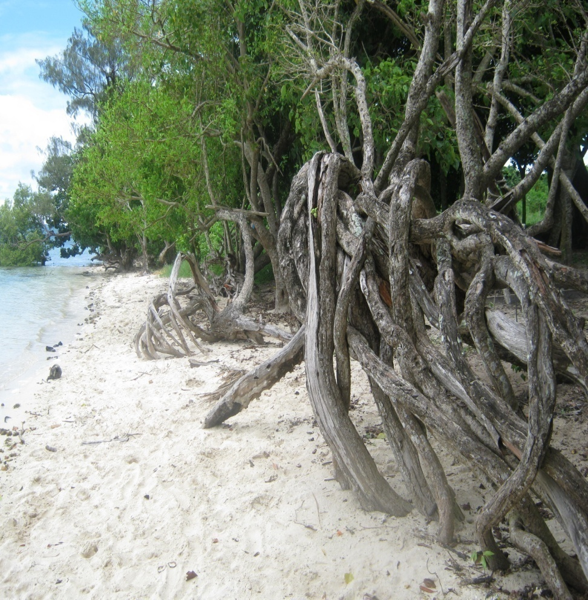
Impacts of CC continue
Butt rot, ringworm and other diseases affecting valuable species.
Slow progress of natural regeneration.
Invasion of weeds and vines in forested areas.
Landslides and coastal erosion.

Slide 5
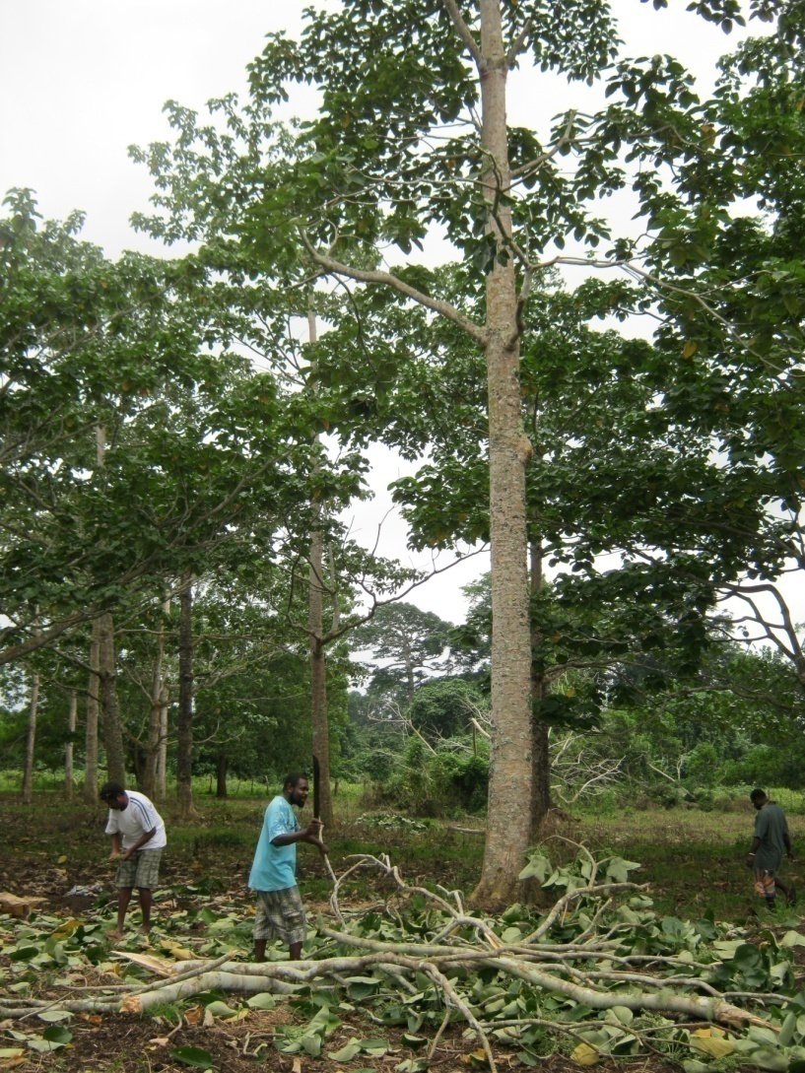
1. Adaptive measures for increased rainfalls and decrease in temperature
Conduct assessment of species severely affected.
Collect seeds, wildings or cuttings from healthy trees and plants of the same species affected.
Raise seeds in a nursery.
Plant seedlings on other locations not affected.
Collection of healthy seeds

Slide 6
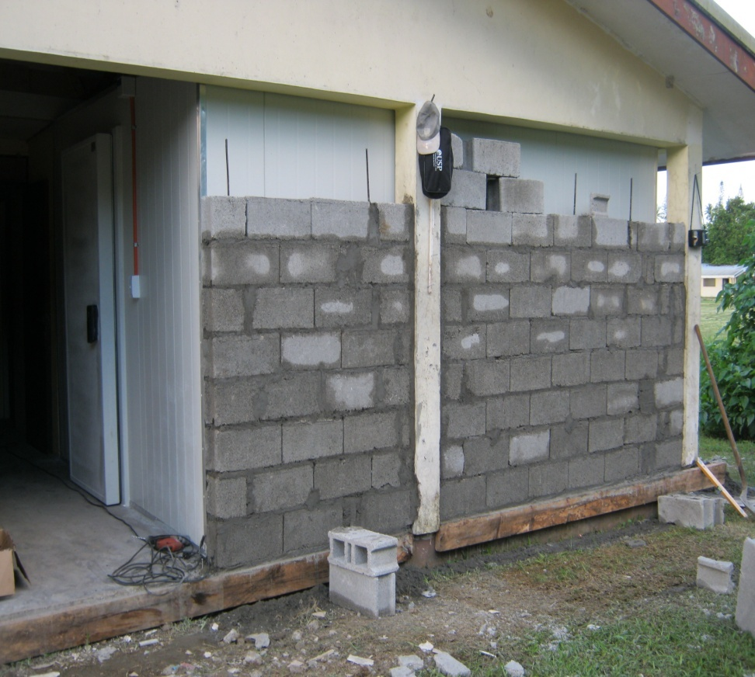
Adaptive measures no. 1 cont..
Relocate plants affected in swamps and wet land areas to seasonal waterlog areas.
Propagate plants to increase planting materials when long wet seasons affect their flowering.
Collect seeds and store them in safe controlled rooms or coolers to be used during low fruiting periods.
Plan eco-tourism activities for dryer areas during prolonged rainy periods.
Establish wildlife corridors from affected areas to stable areas.
Remove animals, plants and birds to areas less affected.
Establish conservation on dry areas to preserve endemic plants and species of cultural importance.
Relocate affected plants to warmer areas.
Construction of Seed storage facility

Slide 7
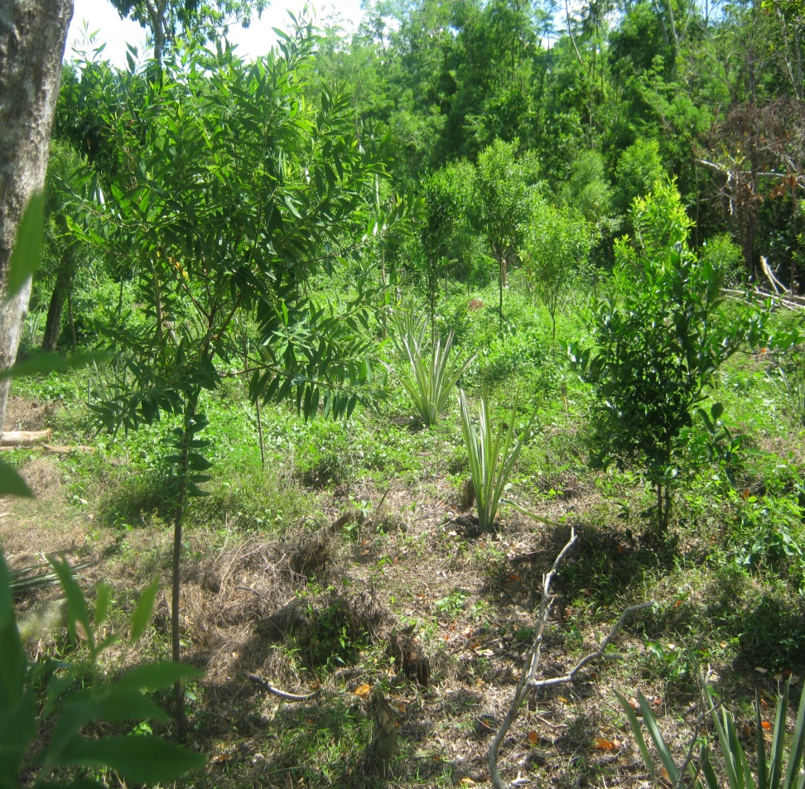
2. Adaptive measures for decreased rainfalls and increased temperatures.
Establish sites specific for each species to ensure planting in right location.
Identify and relocate important species to wetter locations.
Plant tolerant species of high temperature.
Undertake grafting to ensure fruiting under controlled conditions.
Build storages facilities to store seeds for future use.
Use the agro-forestry method.

Slide 8
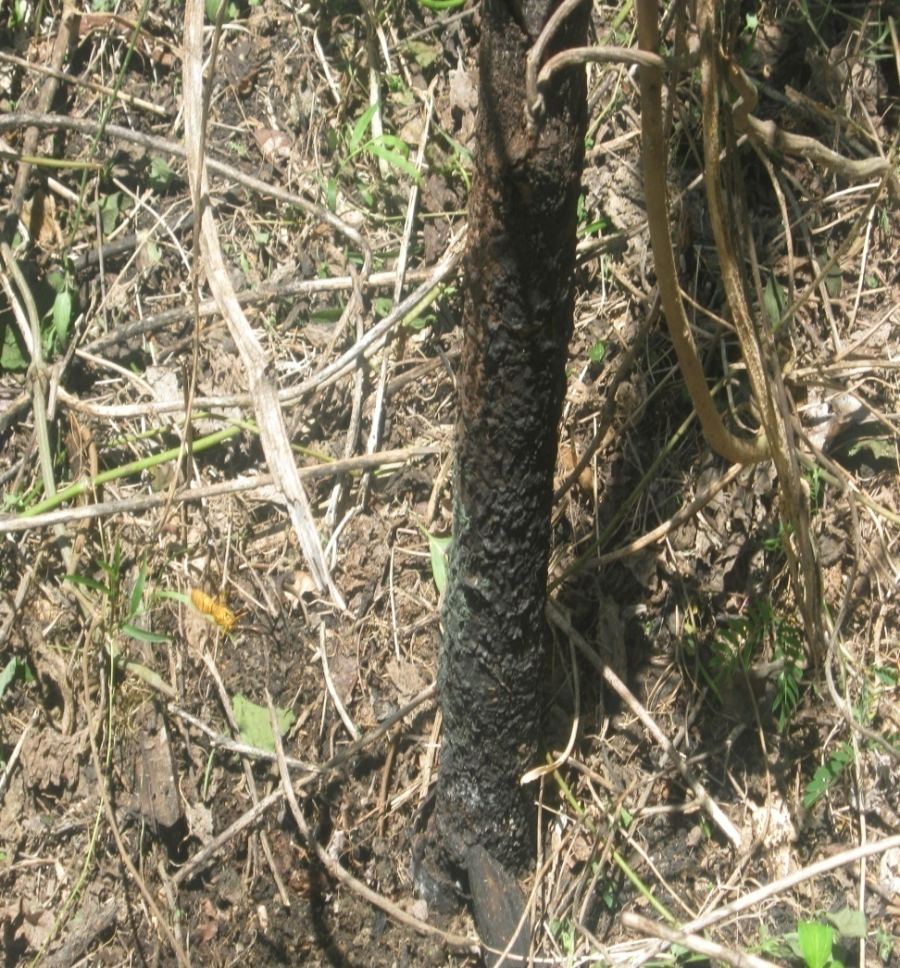
Adaptive measures no. 2 cont..
Undertake awareness on the risks of forest fires.
Identify any outbreak of pest and disease and report to relevant authorities to deal with.
Undertake awareness on the importance of the water catchment areas.
Encourage communities to rehabilitate water catchment areas.
Establish green belts or wind breaks.
Fungi or ringworm on butt of sandalwood

Slide 9
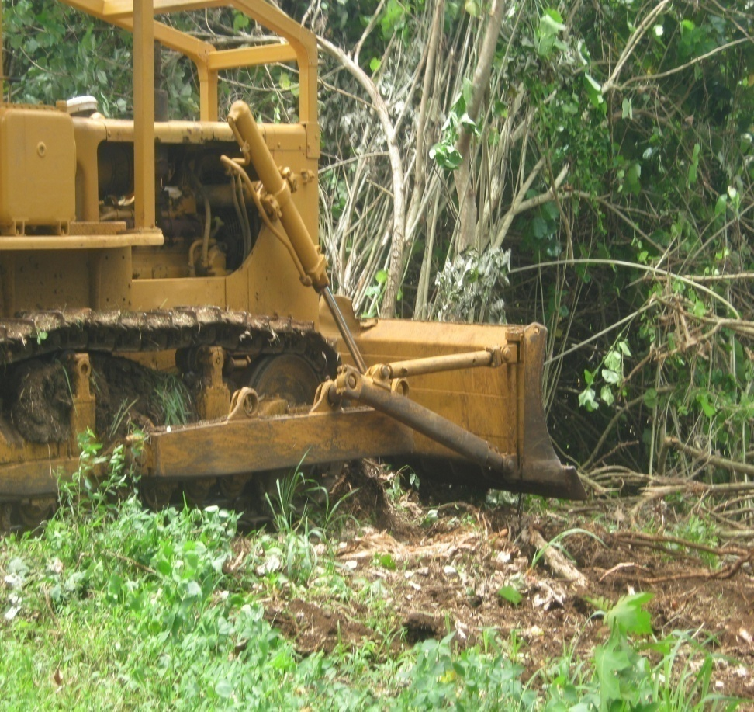
3. Adaptive measures for soil erosion.
Conducted logging operations only in dry periods.
Discourage heavy machinery operation during rainy seasons.
Comply with all the VCOLP requirements and specifications.
Discourage gardening and clearing of vegetation on steep slopes.
Stop mining of sand and coral during high surfs to prevent erosion of coastal species.

Slide 10
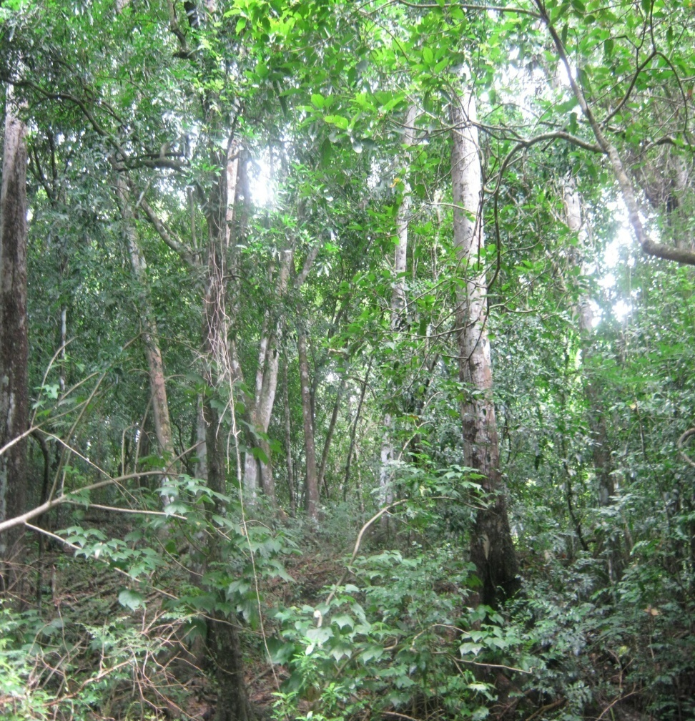
4. Adaptive measures for impacts of server cyclones
Plant local species that are more adaptive to cyclones.
Establish green belts or wind breaks around forest plantations.
Plant species for enrichment of area affected.
Establish seed orchards in secured locations.
Green belt or wind break

Slide 11
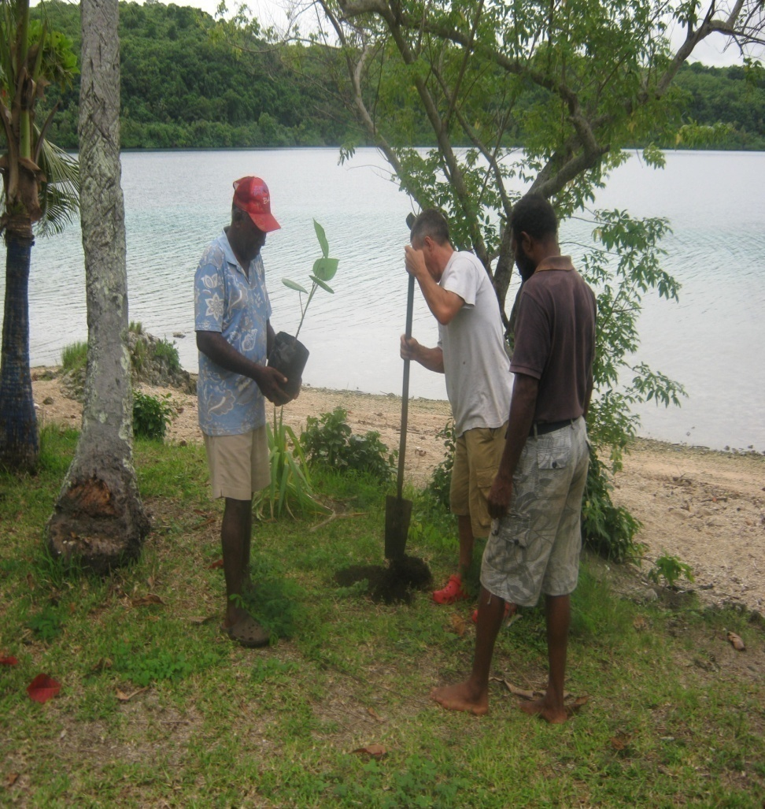
Adaptive measures no. 4 cont..
Plant coastal trees along the coastline to control erosion during cyclone seasons.
Establish 10 to 15 meters buffer zones between coast and village.
Report to relevant authorities on any out break of invasive species.
Control and manage invasive species distributed by cyclones.
Establish forest plantations in areas less affected by cyclones for wood quality.

Slide 12
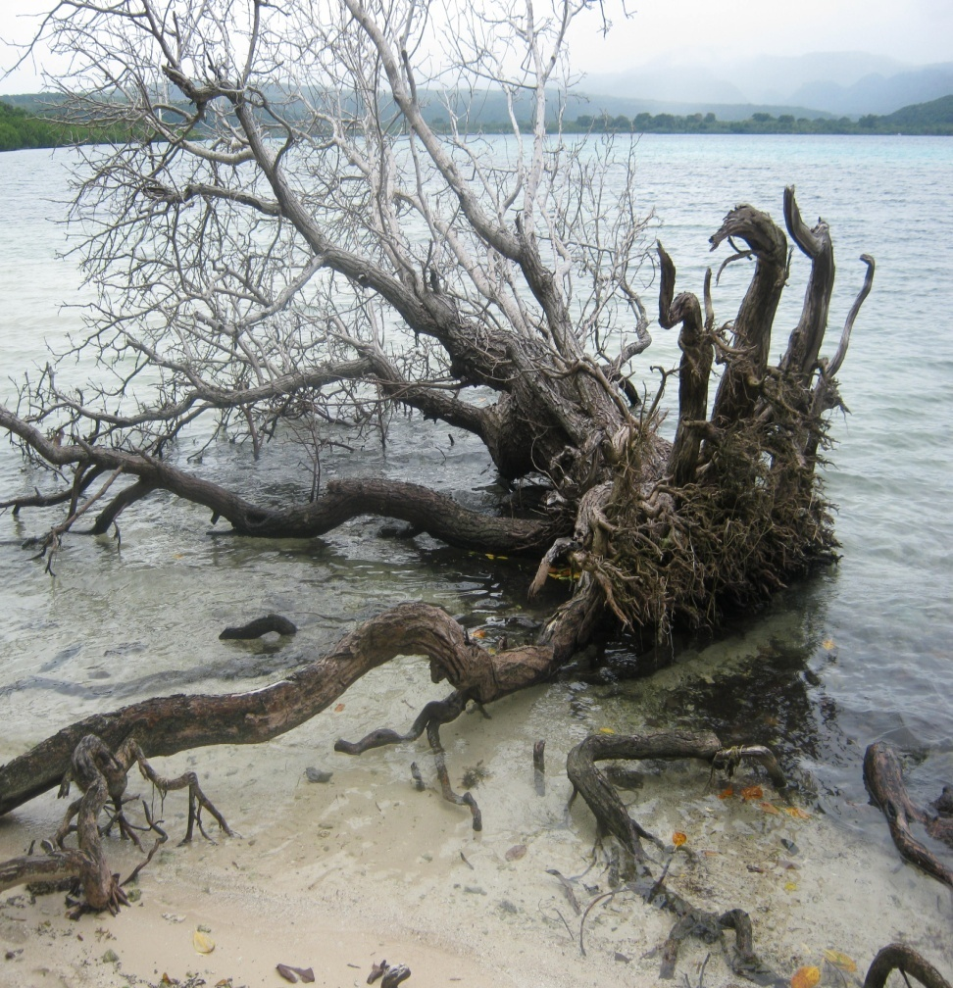
5. Adaptive measures for sea level rise.
Relocate species of importance to higher grounds to avoid loss through sea water flooding.
Identify coastal sites that are severely affected and rehabilitate with coastal species to reduce coastal erosion.
Establish a buffer of coastal species to reduce the rate of coastal erosion.
Establish woodlots and plantations on areas not subject to coastal erosion.
Adapt coastal management plans.

Slide 13
Need to know
Different types of soil.
Temperature.
Rainfall.
Coastal erosion.
Tree species and their roles.
Flower and fruiting seasons.
Stream classes.

Slide 14
Education on CC impacts and adaptation measures
Conduct awareness to communities vulnerable to CC impacts.
Set up pilot sites for species to be relocated.
Train communities on management of buffers, rehabilitation of degraded forests and land, water catchment areas and coastal species.
Increase agro-forestry methods.
Use media outlets in providing specific information on CC impacts with adaptation methods.
Produce leaflets, flyers and posters.

Slide 15
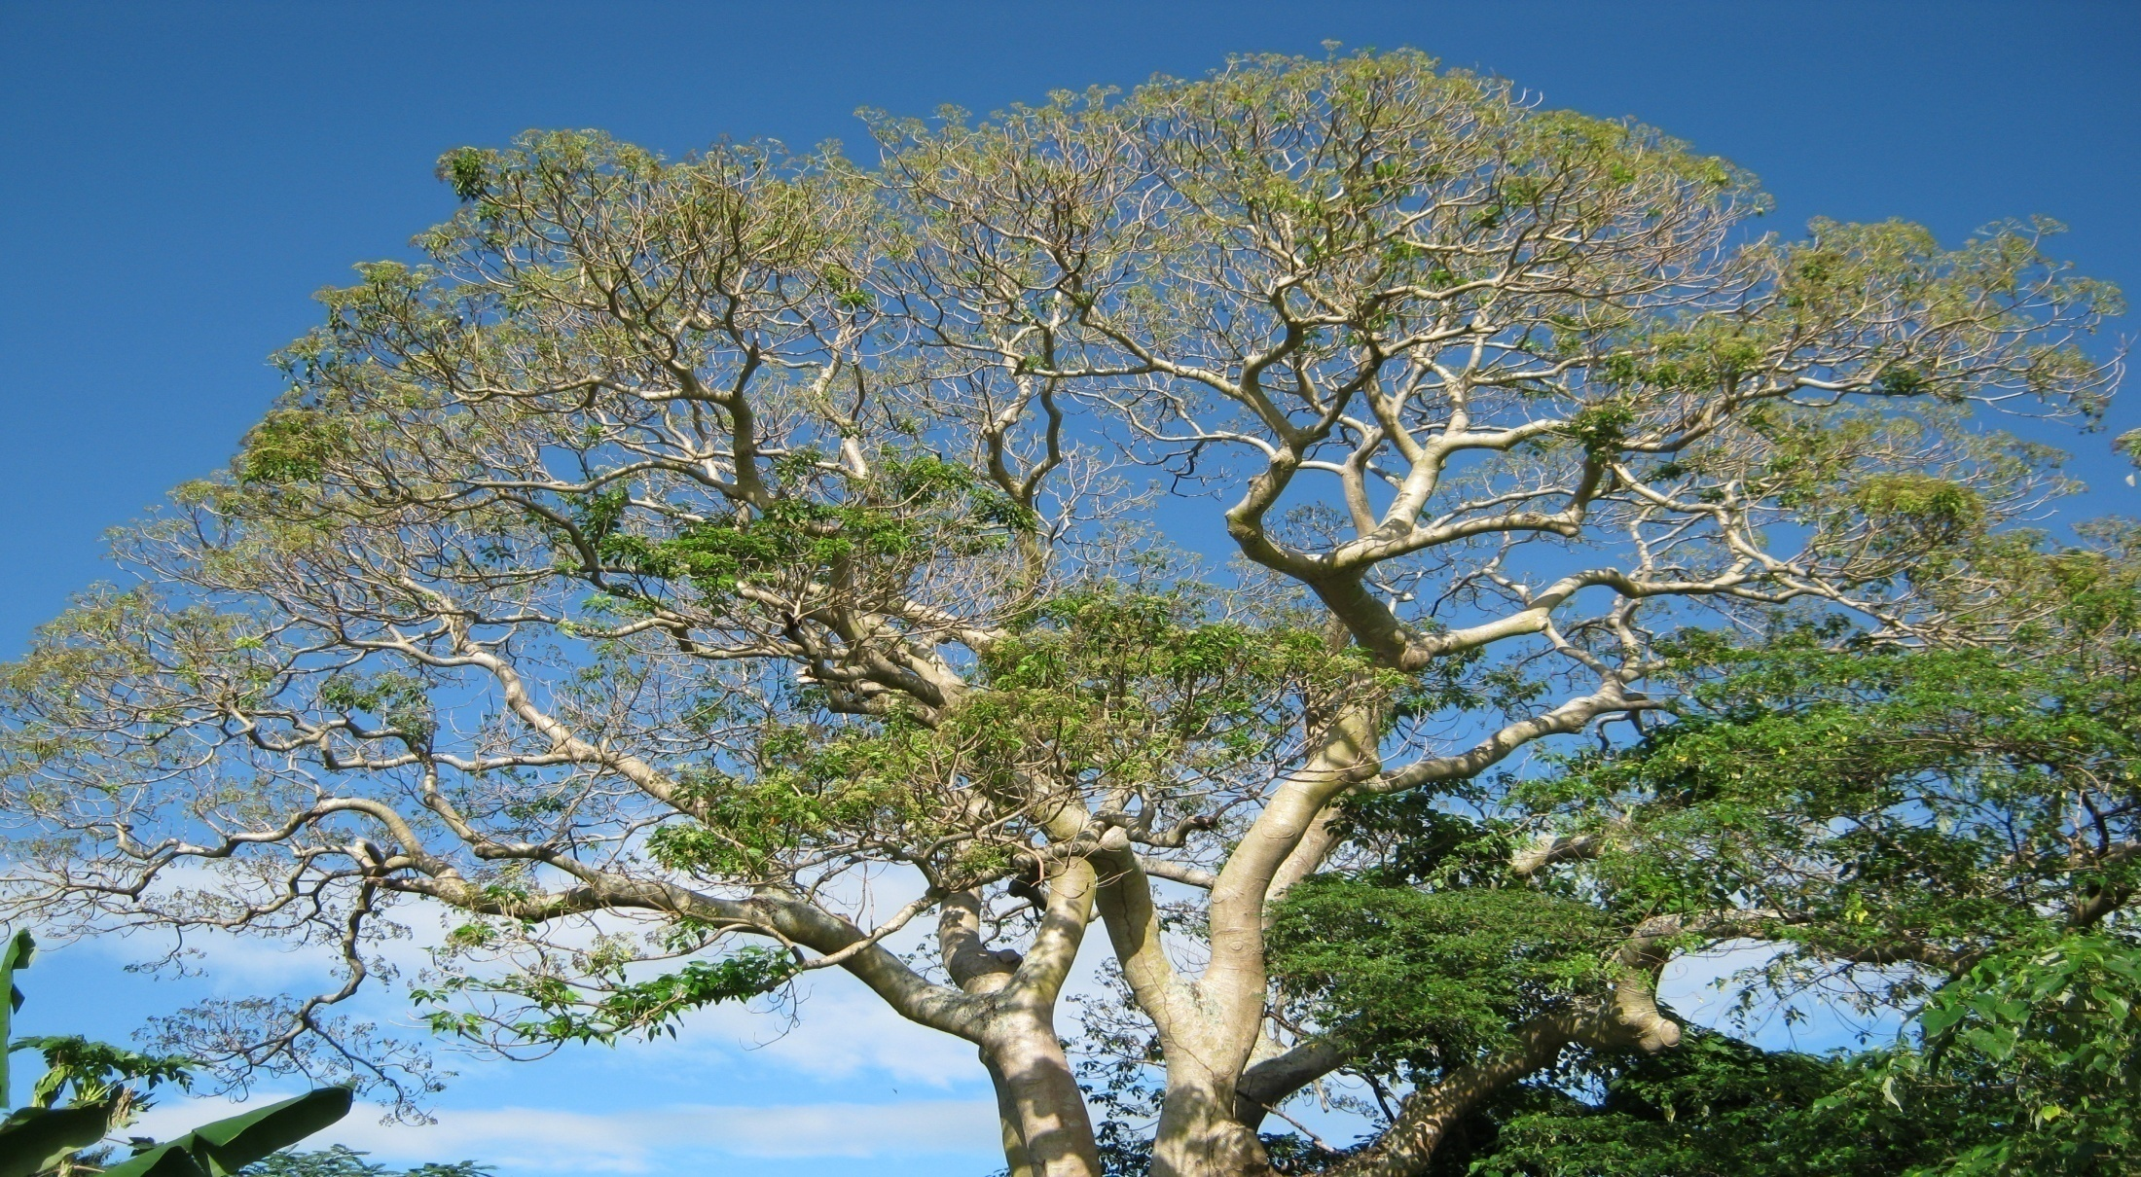
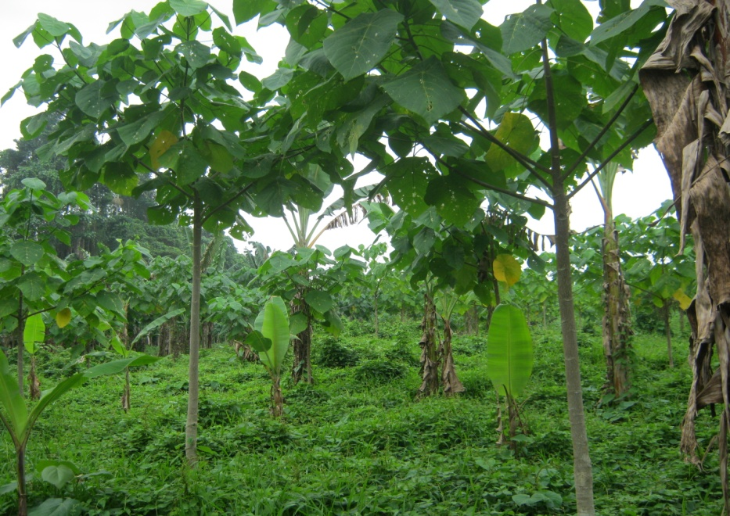
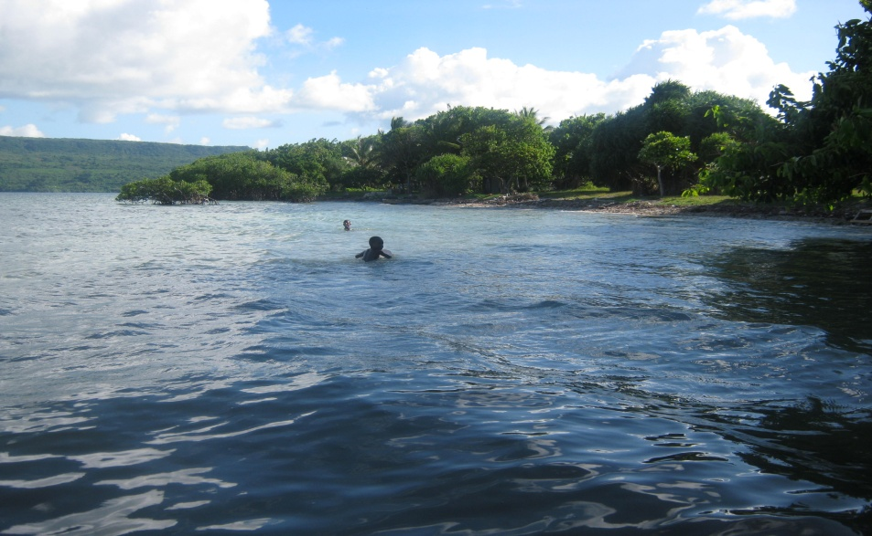
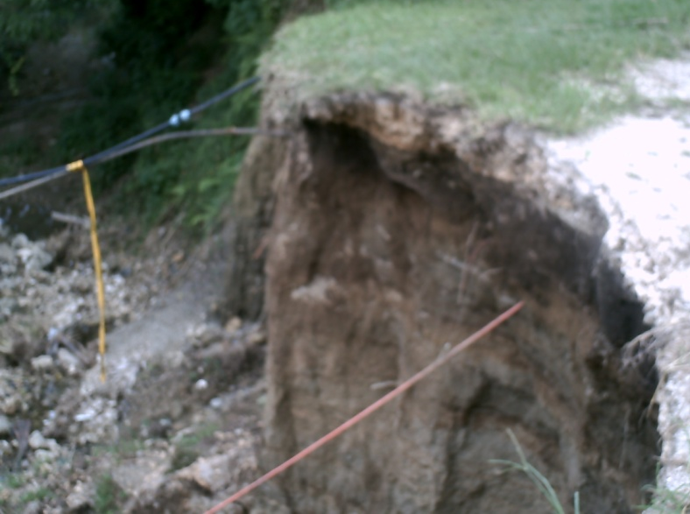
THANKYOU TUMAS

