Slide 1
Vanuatu Project Site: Divers Bay Village, Ureparapara Island, Banks, Torba Province
“Enhanced Climate Change Resiliency of Food Production Systems in Selected Pacific Island Countries”
NAB Briefing on the CC & FS Vulnerability Assessment and Implementation Plan
Port Vila, Vanuatu
17-18th July 2013

Slide 2
Background
Vanuatu is one of the six countries that were selected as pilot project countries for the SPC/USAID project titled “Vegetation and land cover mapping and improving food security for building resilience to a changing climate in Pacific island communities”.
Project Goal:
Evaluate and implement innovative techniques and management approaches to increasing the climate change resilience of land-based food production systems for communities in Fiji, Kiribati, Samoa, Solomon Islands, Tonga and Vanuatu.

Slide 3
Project Objective:
Improved understanding of present and future climate related constraints on sustainable food production in various Pacific Island agriculture ecosystems, and the adoption of innovative adaptation responses that contribute to maintaining or increasing food security
Strengthened national and community capacity to build food security and respond proactively to climate change and climate variability
Improved integration of successful approaches into national and sector climate change adaptation strategies.

Slide 4
Project Components and Activities
Vegetation and Land Cover mapping (Solomon Islands, Fiji and Kiribati)
Adaptation Approaches:
  Site Selection (April 2013)
  CC and FS V&A in selected sites (June 2013)
  Adaptive capacity analysis
  Design and Implement and Evaluate Adaptation Strategies
  Building community awareness to CC variability/impacts and measures to increase resiliency of agri systems
  Policy advise (Enhancing CC resiliency of food production systems)

Slide 5
Briefing Objectives/Outcomes
Update NAB on the following:
Project Selection process and selected project site for Vanuatu
Results of the Climate Change and Food Security vulnerability assessment conducted in Divers Bay Village, Ureparapara, Banks, Torba Province
Adaptation Strategies identified for the project/Draft Project Logframe and Activities
Way forward project implementation arrangements

Slide 6
CC and FS Vulnerability Assessment

Slide 7
Objective
The main objective of the assessment was to:
conduct climate change vulnerability assessments on the land based agricultural production systems. More specifically:
  Assess the degree of vulnerability to climate change on food productions systems in Ureparapara;
  Assess food security situation in Ureparapara;
  Identify adaptation measures to the impacts of climate change on food production systems.

Slide 8
Site Selection Process
Vanuatu Government recommended ten (10) islands as potential sites for the SPC/USAID climate change project. The following criteria were used to prioritise project site:
  Socio-economics – isolation, population trend, income, access to services, etc.
  Food production systems –level of management practices for replication of successful models
  Biodiversity/agro-biodiversity –high biodiversity to be protected
  Topography – flood plains, slope
  Climate change impacts
  Non-Climatic factors – soil fertility, pest and diseases etc..
  Accessibility and level of support

Slide 9
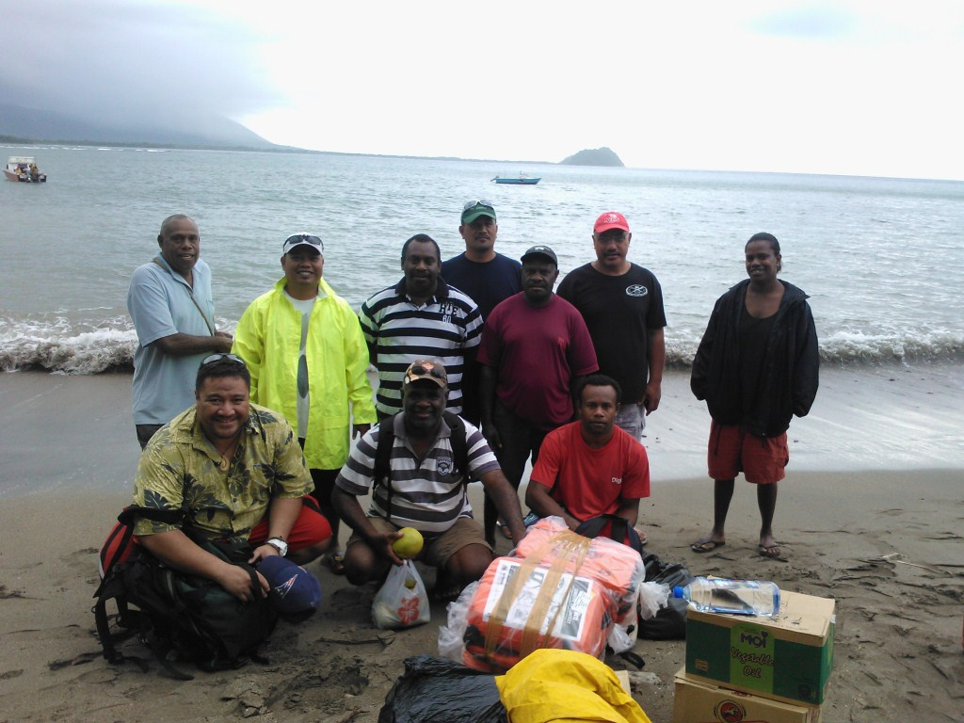
The Process and Assessment Team
The assessment was conducted from 10th - 14st June 2013
(4) SPC technical staff,
four (4) Department of Agriculture and Rural Development staff,
one (1) Department of Forestry staff and
one (1) Department of Fisheries staff.

Slide 10
Figure1. SPC LRD ASSESSMENT FRAMEWORK
FUNDING FROM USAID
“Vulnerability is a function of character, magnitude and rate of climate variation to which a system is exposed, its sensitivity, and its adaptive capacity” (IPCC, 2001). This definition is articulated in the following equation for simplicity: V=E x S/A.

Slide 11
Table 2. Divers Bay Village Exposure to Climatic change
Variable | Description | Community Perception | Scale Value
Temperature | Number of hot days has increased | Very High | 4.00
 | Number of cold days has decreased | High | 3.00
Rainfall | Rainfall has become increasingly unpredictable | High - Very High | 3.67
Climate induced disasters | Occurrence of Landslides has increased and sea level rise | Medium - High | 2.67
 | Occurrence of drought has decreased | High | 3.00
Mango | Not fruiting for about ten years | Very High | 4.00
Breadfruit | Unlike before, fruiting all year round | High | 3.00
Yams | Shorter Season but smaller tubers and more diseases (Anthracnose) | High | 3.00
Cassava | Smaller tubers and taste change (bitter) and harder tubers; rat problems | Medium | 2.00
Banana | Fruits are smaller and taste changed (saltier); more damage from fowls | Low | 1.00
Pigs | Higher mortality; less pigs now; slow growth; low survival rate | High | 3.00
Chicken | Lowered egg production = less number of chickens; eye disease problem | High | 3.67
Fish/Crab | Less fish/Inconsistent catches | Very High | 4.00
Total |  |  | 40.00
Average Exposure Index: |  | High | 3.08

Slide 12
Table 3. Dives Bay Village Sensitivity to Climate Change
Sector | Hazards | Indicators | Community Perception | Scale Value
Agriculture and Food Security | Landslides & Cyclone | Agricultural land damaged | High | 3.67
 | Cyclone & landslides | Loss of Crop lands | High | 3.33
Forest and Biodiversity | Cyclone | Loss of Forest cover | High | 3.00
 | Cyclone | Loss of Forest products | High | 3.33
Water | Cyclone and landslides | Reduced quantity of water | High | 3.33
 | Cyclone and landslides | 6 months to recover water quality | High | 3.33
 | Cyclone and landslides | Reduced Quality of water | High | 3.67
Settlement and Infrastructure | Cyclone and landslides | Damaged infrastructure | Very High | 4.00
 | Cyclone | All infrastructure (houses) damaged | Very High | 4.00
Human Health | Cyclone and landslides | Outbreak of Malaria & diarrhoea | High | 3.33
 | Cyclone and landslides | Number of people (majority of the population) | Very High | 4.00
Average Index Score: |  |  | High | 3.55

Slide 13
Table 4. Dives Bay Village Adaptive Capacity to Climate Change
Parameters | Indicators | Criteria | Community Perception | Scale Value
Natural Assets | Agriculture Land | Land use and productivity | M | 2.00
 | Forests Land & Forest products | Availability of product and services | M | 2.00
 | Water | Availability of drinking water and Water Quality | L | 1.67
Physical Assets | Infrastructure for services | Trails | L | 1.67
 |  | Drinking water and electricity | L | 1.67
 |  | Settlements and Community Hall | M | 2.00
 |  | Housing standards | M | 2.00
 |  | Access to transportation (land, air, sea) | L | 1.33
 |  | Access to Health Posts | L | 1.67
 |  | Access to Schools | M | 2.00
 | Information and communication sources | Access to mobile phones, radio, TVs, papers, and internet | L | 1.33
Social | Social institutions and service providers | Community affiliations to formal/non-formal institutions and engagements of NGOs and GOs with community | L | 1.00
Financial | Financial institutions and sufficiency of incomes | Access to Banks, cooperatives and sufficiency for household needs | L | 1.00
Human | Demography, Education, Skilled Labour | More elderly and young (lack trained or skilled labour and low education levels) | L | 1.00
Total |  |  |  | 22.33
Average Index Score |  |  | Low | 1.60

Slide 14
Vulnerability index of Divers Bay
Vulnerability (V) = EXS/A
= 3.08 X 3.55/1.60
= 6.84 (VERY HIGH)

Slide 15
Table 5. Population Demographics
Village | No. of households | Population |  |  | Education – elementary plus
 |  | Male | Females | Total
Ureparapara | 94 | 226 | 211 | 437 | 84.6% Pre-school/Elementary and 15.4% High School
Table 6. Households Income
Village | Weekly Income Sources ($VATU) |  |  |  |  |  | Income Sufficiency | Expenses Impacting financial situation most
 | Farming | Cooked food | Handicrafts | Other | Total | Income/ households | %
Divers Bay | 19900 | 1300 | 2500 | 32500 | 58700 | 1087.037 | 90 | School fees (1), Church Obligations (1) and food security (2)

Slide 16
Table 7. Housing types, Water Sources and Facilities
Village | Living Quarters | Water sources |  | Toilet Facilities | Power & Light | Cooking
 |  | Drinking | Washing
Divers Bay | Independent (38%) Share 62% Bamboo (15%) Thatch (85%) | Household tank (77%) Community water supply (8%) Unprotected well & Spring 15%) | Spring (100%) | Outhouse pit toilet (100%) | Solar Panels/ Generator (38%) None (62%) 92% Battery Lamp | Open fire (100%)
Table 8. Land Access and Land Use
Village | % HH have land | Average size (acre) | Land Quality | % Grow own food | Interest for tree
Divers Bay | 100 | 6.42 | Good (23%) Average (77%) | 100 | Fruit tree & Timber (84%) Firewood and other (69%)

Slide 17
Table 9. Food Availability (WHO & SPC, 2009)
Country | Kcalorie/per/day | % Import
Fiji | 3663 | 51
Kiribati | 3534 | 63.7
Solomon Islands | 2422 | 55.8
Vanuatu | 2757 | 49.2
Cook Islands | 3185 | 83.4
Samoa | 2886 | >60%
Marshall Islands | 2950 | 89
Food availability does not mean all people access this amount.
Proportion of food imported is quite alarming

Slide 18
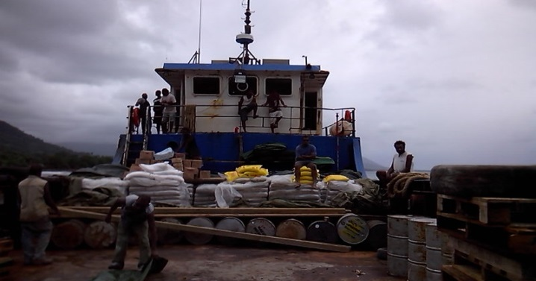
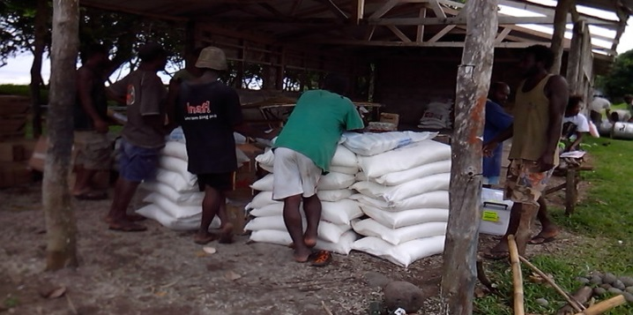
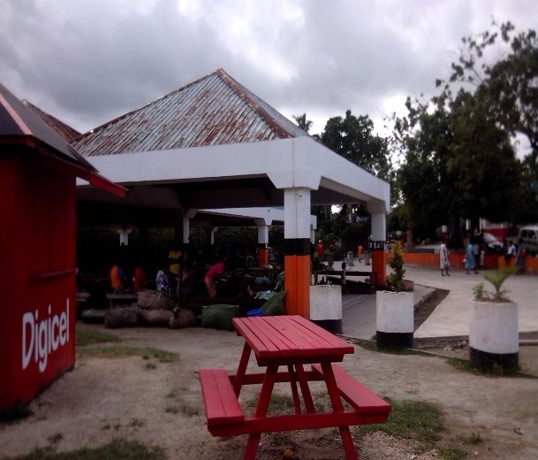
Table 10. Energy Supply for Divers Bay
Quantity / Person /day | Xan- thosoma | Sweet potato | Cassava | Banana | Total Local | Rice | Flour | Noodle | Total Import | Tot./ person/day | % Import
g | 106.9 | 114.8 | 134.1 | 154.4 | 510.2 | 22.5 | 37.1 | 9.8 | 69.4 | 579.6 | 24.5%
kcal | 91.9 | 105.7 | 485.3 | 92.6 | 775.5 | 81.1 | 135.0 | 36.0 | 252.1 | 1027.6
Table 11. Protein Supply for Divers Bay
Quantity / | Pig | Chicken | Tuna and Deep fish | Reef fish | Total Local | Can fish | Can meat | Chicken | Tot import | Tot./ person/day | % Import
person/ day
g | 4.9 | 6.5 | 14.3 | 4.2 | 29.9 | 8.1 | 2.7 | 1.1 | 11.9 | 41.8
kcal | 15.9 | 8 | 12.3 | 2.7 | 38.9 | 14.9 | 6.3 | 1.3 | 22.6 | 61.4 | 36.81%

Slide 19
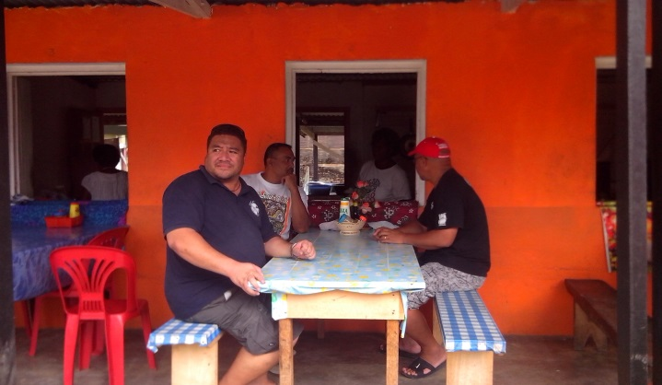
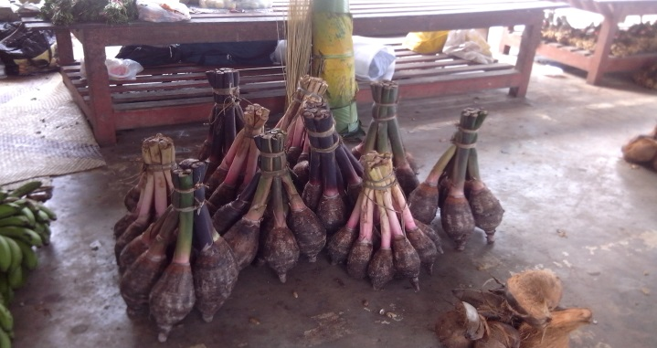
Food Access - Households
Food access is determined by the household’s/individual’s access to resources to either produces the food or enough income to purchase a sufficient and safe food.
Most households in both village have access to land to grow their own food. HIES suggests low production.
Income generating opportunity for the community is very low. Copra main source of income and handicrafts during visiting vessels

Slide 20
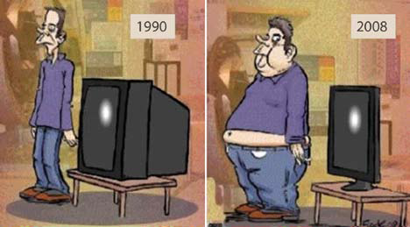
Food Utilisation
Accessing food does not mean nutritional security
Food utilisation is still very much reliance on local food production.
However, there is a need to strengthen food production to reverse the already established tendency for reliance on imported foods.
Diversification of food production systems will ultimately increase diet diversity.

Slide 21
DOUBLE BURDEN (WHO/SPC, 2009)
Prevalence (%) of female anaemia and obesity in the Pacific
Source: Fortification in the Pacific. Technical item 5.5. Report of the 2007 WHO/SPC Meeting of Pacific Ministers of Health. WPRO Manila

Slide 22
Stability
Climate Variability and impacts
HIES suggests low production
Low production diversity
Land access but topography of the island = production systems are vulnerable
Low income/income opportunities

Slide 23
Table 12. Transect Walk Observations
The village & Farming Systems | Main Type of Crops | Livestock
Issues: Village is located in valley near the coastal area, vulnerable to natural disasters and sea level rise Limited access to communication and basic services Need diversification of agroforestry species Need proper spacing recommendations Area is vulnerable to landslides due to steep mountain (need proper farming systems for slopy lands) | Issues: Copra is the main source of income but with the limited transport, copra is usually not sold; limited diversity Nutrient and pest and disease problems observed on root crops Fruit fly on citrus fruits Anthracnose disease affecting yams Limited diversity of Vegetables; Insect boring on bele leaves | Issues: Very limited livestock number observed Communities indicated that the number of livestock is decreasing resulting in low land based protein source for communities Need to increase land protein based

Slide 24
Major Issues Identified from the Study
CC variability and change impacting different sectors
Limited capacity in CC and DRM
Food Insecure
Low Income
Tendency to rely on food imports
Topography (vulnerability)
Limited diversity
Low food production
Production problems (Soil fertility/pests and diseases)

Slide 25
RECOMMENDATIONS AND ADAPTATION STRATEGIES
From the results of this study (High Vulnerability to Climate Change and Food Security Risks) and in line with the SPC/USAID project purpose (Enhanced Climate Change Resilience of Food Production Systems), below are some adaptation strategies the project will focus on:
  Social strengthening
  Diversification of food production systems in order to ultimately diversify diet
  Introduction of hardy crop varieties
  Introduction of hardy livestock breeds
  Development of demonstration farms (both crop and livestock)
  Capacity Building in all areas of intervention including climate change and disaster risk reduction programs

Slide 26
Project Logframe (Refer to Handout)
Objectives & activities | Objectives Verifiable Indicators (OVIs) | Baseline | End of the Project | Means of Verification (MOVS) | Assumptions
GOAL: Agriculture production and productivity increased
PURPOSE: Resiliency of Agriculture production systems strengthened | Crop area increased Livestock production increased Crop diversity increased Production problems reduced | Low crop production Limited crop diversity Pest and disease problems Low livestock production | Crop diversity increased Crop production and productivity increased Livestock production increased | Project reports Project survey | Limited capacity in agriculture farming techniques Limited access to extension services Strong participation of community members

Slide 27
Project Logframe Cont’d.
OUTPUTS: Diversity and productivity of crops and livestock increased | # of crops varieties introduced and utilised Increased yield # of livestock/breeds increased On farm trials established Capacity building provided | Limited crop diversity Poor agriculture farming practices Low livestock production Lack of capacity in livestock production Low diet diversity | % increase in crop area & agroforestry % increase livestock numbers (pigs and chickens) Diet diversity increased | project reports Project survey | Limited farming techniques Strong support from Govt and donors Strong support from partner agencies/stakeholders Strong participation of community members

Slide 28
Project Logframe Cont’d.
Community Adaptation Capacity strengthened | Income from agriculture sales increased Climate tolerant varieties introduced and distributed Appropriate farming systems adopted Capacity building on agriculture production systems and CC/DRM provided | Limited income opportunity Limited market access Poor access to basic/agri. services and communications Poor agriculture farming practices Limited capacity/knowledge on CC adaptation and DRM |  |  | Income opportunity enhanced % increase in agriculture sales Pest and disease problems identified and control measures provided Appropriate farming practices adopted Agriculture production problems reduced CC / DRM awareness and capacity strengthened |  |  | Project reports Project survey | Limited capacity in agriculture farming techniques Limited access to services Strong support from partner agencies/stakeholders Strong participation of community members

Slide 29
3. Aquaculture farming promoted | at least one aquaculture farm introduced increased protein intake/availability for the community | low protein intake limited protein diversity | increased protein availability | project survey | strong support from community

Slide 30
Recommendations
NAB is requested to:
Note/endorse the project site for Vanuatu (Ureparapara) given their degree of vulnerability;
Note/endorse the findings of the CC and FS V&A for the project site;
Endorse the project logframe (attachment);
Recommend collaboration from other projects such as the World Bank project on food security to reduce the community vulnerability and improve livelihoods;

